Slide 1
Firewalls

Slide 2



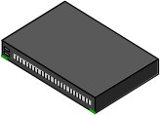

Firewalls
Idea: separate local network from the Internet
Trusted hosts and networks
Firewall
Intranet
Router
DMZ
Demilitarized Zone: publicly accessible servers and networks

Slide 3
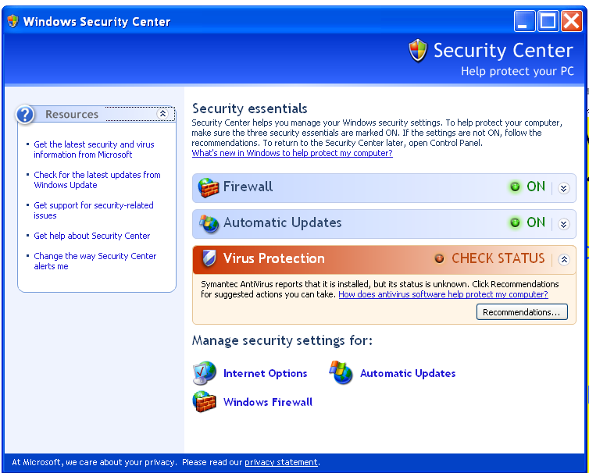
Firewall Locations in the Network
Between internal LAN and external network
At the gateways of sensitive subnetworks within the organizational LAN
  Payroll’s network must be protected separately within the corporate network
On end-user machines
  “Personal firewall”
  Microsoft’s Internet Connection
  Firewall (ICF) comes standard
  with Windows XP

Slide 4
Firewall Types
Packet- or session-filtering router (filter)
Proxy gateway
  All incoming traffic is directed to firewall, all outgoing traffic appears to come from firewall
  Application-level: separate proxy for each application
    Different proxies for SMTP (email), HTTP, FTP, etc.
    Filtering rules are application-specific
  Circuit-level: application-independent, “transparent”
    Only generic IP traffic filtering
Personal firewall with application-specific rules
  E.g., no outbound telnet connections from email client

Slide 5
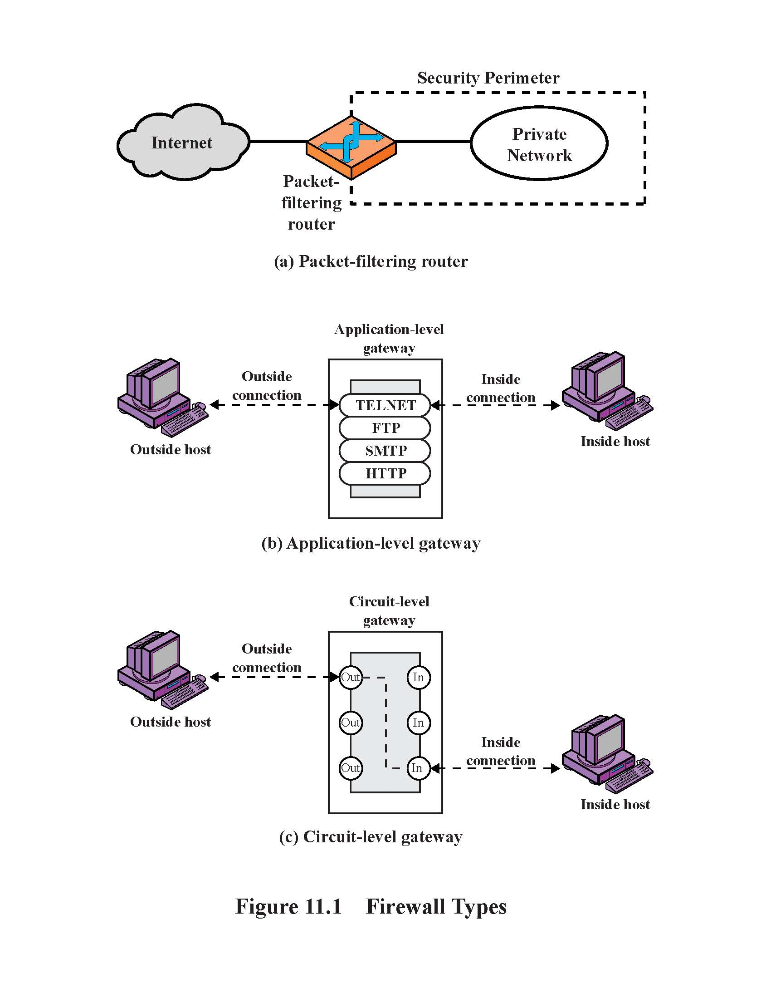
Firewall Types

Slide 6
Packet Filtering
For each packet, firewall decides whether to allow it to proceed
  Decision must be made on per-packet basis
    Stateless; cannot examine packet’s context (TCP connection, application to which it belongs, etc.)
To decide, use information available in the packet
  IP source and destination addresses, ports
  Protocol identifier (TCP, UDP, ICMP, etc.)
  TCP flags (SYN, ACK, RST, PSH, FIN)
  ICMP message type
Filtering rules are based on pattern-matching

Slide 7
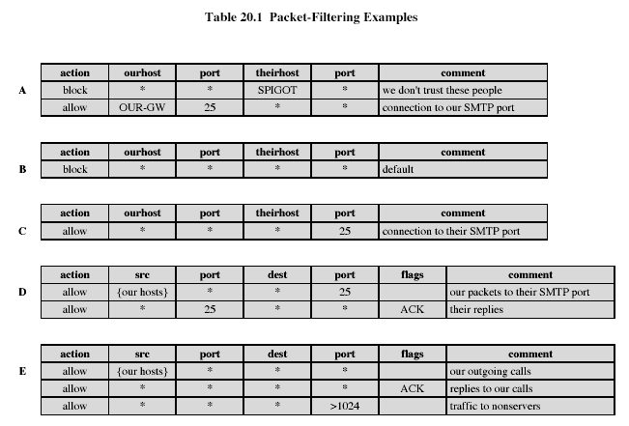
Packet Filtering Examples

Slide 8

Example: FTP
FTP server
FTP client
20
Data
21
Command
Connection from a random port on an external host
5150
5151
◆ Client opens command channel to server; tells server second port number
◆
“PORT 5151”
❖
⬥
❖ Server acknowledges
“OK”
DATA CHANNEL
⬥ Server opens data channel to client’s second port

TCP ACK
 Client acknowledges

Slide 9
FTP Packet Filter
The following filtering rules allow a user to FTP from any IP address to the FTP server at 172.168.10.12
access-list 100 permit tcp any gt 1023 host 172.168.10.12 eq 21
access-list 100 permit tcp any gt 1023 host 172.168.10.12 eq 20
! Allows packets from any client to the FTP control and data ports
access-list 101 permit tcp host 172.168.10.12 eq 21 any gt 1023
access-list 101 permit tcp host 172.168.10.12 eq 20 any gt 1023
! Allows the FTP server to send packets back to any IP address with TCP ports > 1023
interface Ethernet 0
access-list 100 in ! Apply the first rule to inbound traffic
access-list 101 out ! Apply the second rule to outbound traffic
!
Anything not explicitly permitted by the access list is denied!

Slide 10
Weaknesses of Packet Filters
Do not prevent application-specific attacks
  For example, if there is a buffer overflow in URL decoding routine, firewall will not block an attack string
No user authentication mechanisms
  … except (spoofable) address-based authentication
  Firewalls don’t have any upper-level functionality
Vulnerable to TCP/IP attacks such as spoofing
  Solution: list of addresses for each interface (packets with internal addresses shouldn’t come from outside)
Security breaches due to misconfiguration

Slide 11
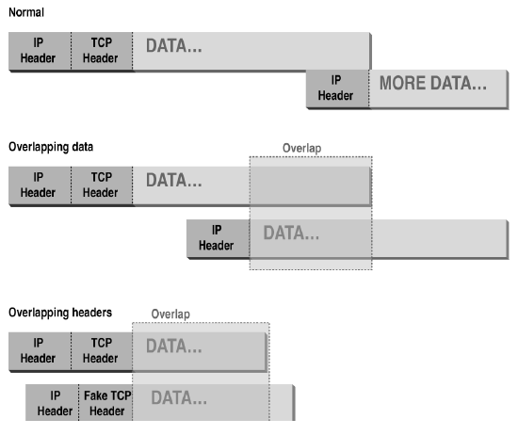
Abnormal Fragmentation
For example, ACK bit is set in both fragments,
but when reassembled, SYN bit is set
(can stage SYN flooding through firewall)

Slide 12
Fragmentation Attack
Telnet Server
Telnet Client
, Send 2 fragments with the ACK bit set; fragment offsets are chosen so that the full datagram re-assembled by server forms a packet with the SYN bit set (the fragment offset of the second packet overlaps into the space of the first packet)
23
Allow only if ACK bit set
1234
◆
FRAG1 (with ACK)
❖
FRAG2 (with ACK)
SYN packet (no ACK)
⬥
ACK
⬥ All following packets will have the ACK bit set

Slide 13
More Fragmentation Attacks
Split ICMP message into two fragments, the assembled message is too large
  Buffer overflow, OS crash
Fragment a URL or FTP “put” command
  Firewall needs to understand application-specific commands to catch this
chargen attacks
  “Character generation” debugging tool: connect to a certain port and receive a stream of data
  If attacker fools it into connecting to itself, CPU locks

Slide 14
Stateless Filtering Is Not Enough
In TCP connections, ports with numbers less than 1024 are permanently assigned to servers
  20,21 for FTP, 23 for telnet, 25 for SMTP, 80 for HTTP…
Clients use ports > 1024
  They must be available for clients to receive responses
What should a firewall do if it sees, say, an incoming request to some client’s port 5612?
  It must allow it: this could be a server’s response in a previously established connection…
  …OR it could be malicious traffic
  Can’t tell without keeping state for each connection

Slide 15
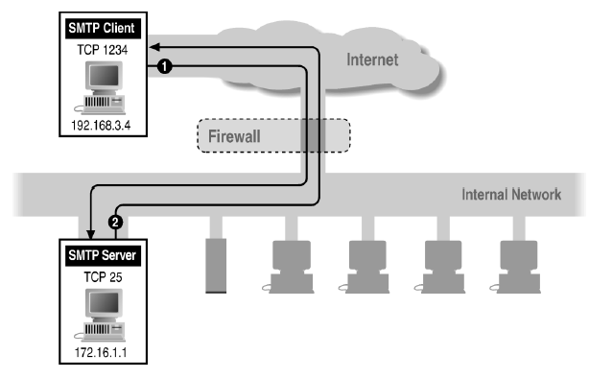
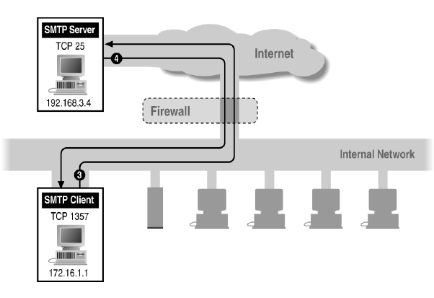
Example: Variable Port Use
Inbound SMTP
Outbound SMTP

Slide 16
Session Filtering
Decision is still made separately for each packet, but in the context of a connection
  If new connection, then check against security policy
  If existing connection, then look it up in the table and update the table, if necessary
    Only allow incoming traffic to a high-numbered port if there is an established connection to that port
Hard to filter stateless protocols (UDP) and ICMP
Typical filter: deny everything that’s not allowed
  Must be careful filtering out service traffic such as ICMP
Filters can be bypassed with IP tunneling

Slide 17
Example of Tunneling
A
B
E
F
Logical view:
tunnel
IPv6
IPv6
IPv6
IPv6
A
B
C
D
E
F
Physical view:
IPv6
IPv6
IPv4
IPv4
IPv6
IPv6
Flow: X
Src: A
Dest: F
data
Src:B
Dest: E
Src:B
Dest: E
Flow: X
Src: A
Dest: F
data
Flow: X
Src: A
Dest: F
data
Flow: X
Src: A
Dest: F
data
A-to-B:
IPv6
B-to-C:
IPv6 inside
IPv4
B-to-C:
IPv6 inside
IPv4
E-to-F:
IPv6

Slide 18
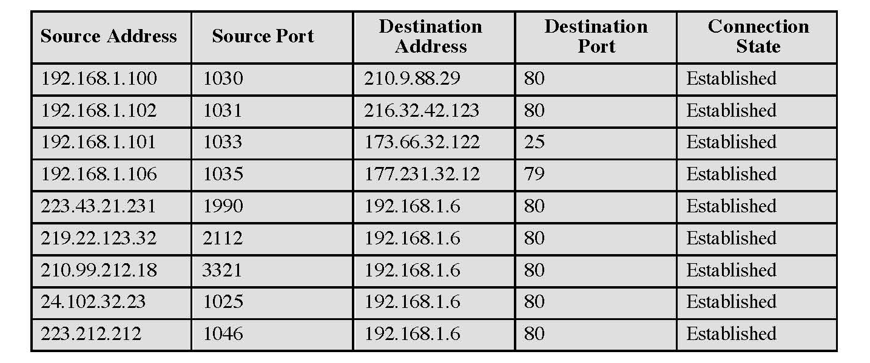
Example: Connection State Table

Slide 19
Application-Level Gateway
Splices and relays two application-specific connections
  Example: Web browser proxy
  Daemon spawns proxy process when communication is detected
  Big processing overhead, but can log and audit all activity
Can support high-level user-to-gateway authentication
  Log into the proxy server with your name and password
Simpler filtering rules than for arbitrary TCP/IP traffic
Each application requires implementing its own proxy

Slide 20
Circuit-Level Gateway
Splices two TCP connections, relays TCP segments
Less control over data than application-level gateway
  Does not examine the contents of TCP segment
Client’s TCP stack must be aware of the gateway
  Client applications are often adapted to support SOCKS
Often used when internal users are trusted
  Application-level proxy on inbound connections, circuit-level proxy on outbound connections (lower overhead)

Slide 21
Comparison
Modify client
application
Defends against
fragm. attacks
Performance
Packet filter Best No No
Session filter No Maybe
Circuit-level gateway Yes (SOCKS) Yes
Application-level Worst Yes Yes
gateway

Slide 22
Bastion Host
Bastion host is a hardened system implementing application-level gateway behind packet filter
  All non-essential services are turned off
  Application-specific proxies for supported services
    Each proxy supports only a subset of application’s commands, is logged and audited, disk access restricted, runs as a non-privileged user in a separate directory (independent of others)
  Support for user authentication
All traffic flows through bastion host
  Packet router allows external packets to enter only if their destination is bastion host, and internal packets to leave only if their origin is bastion host

Slide 23
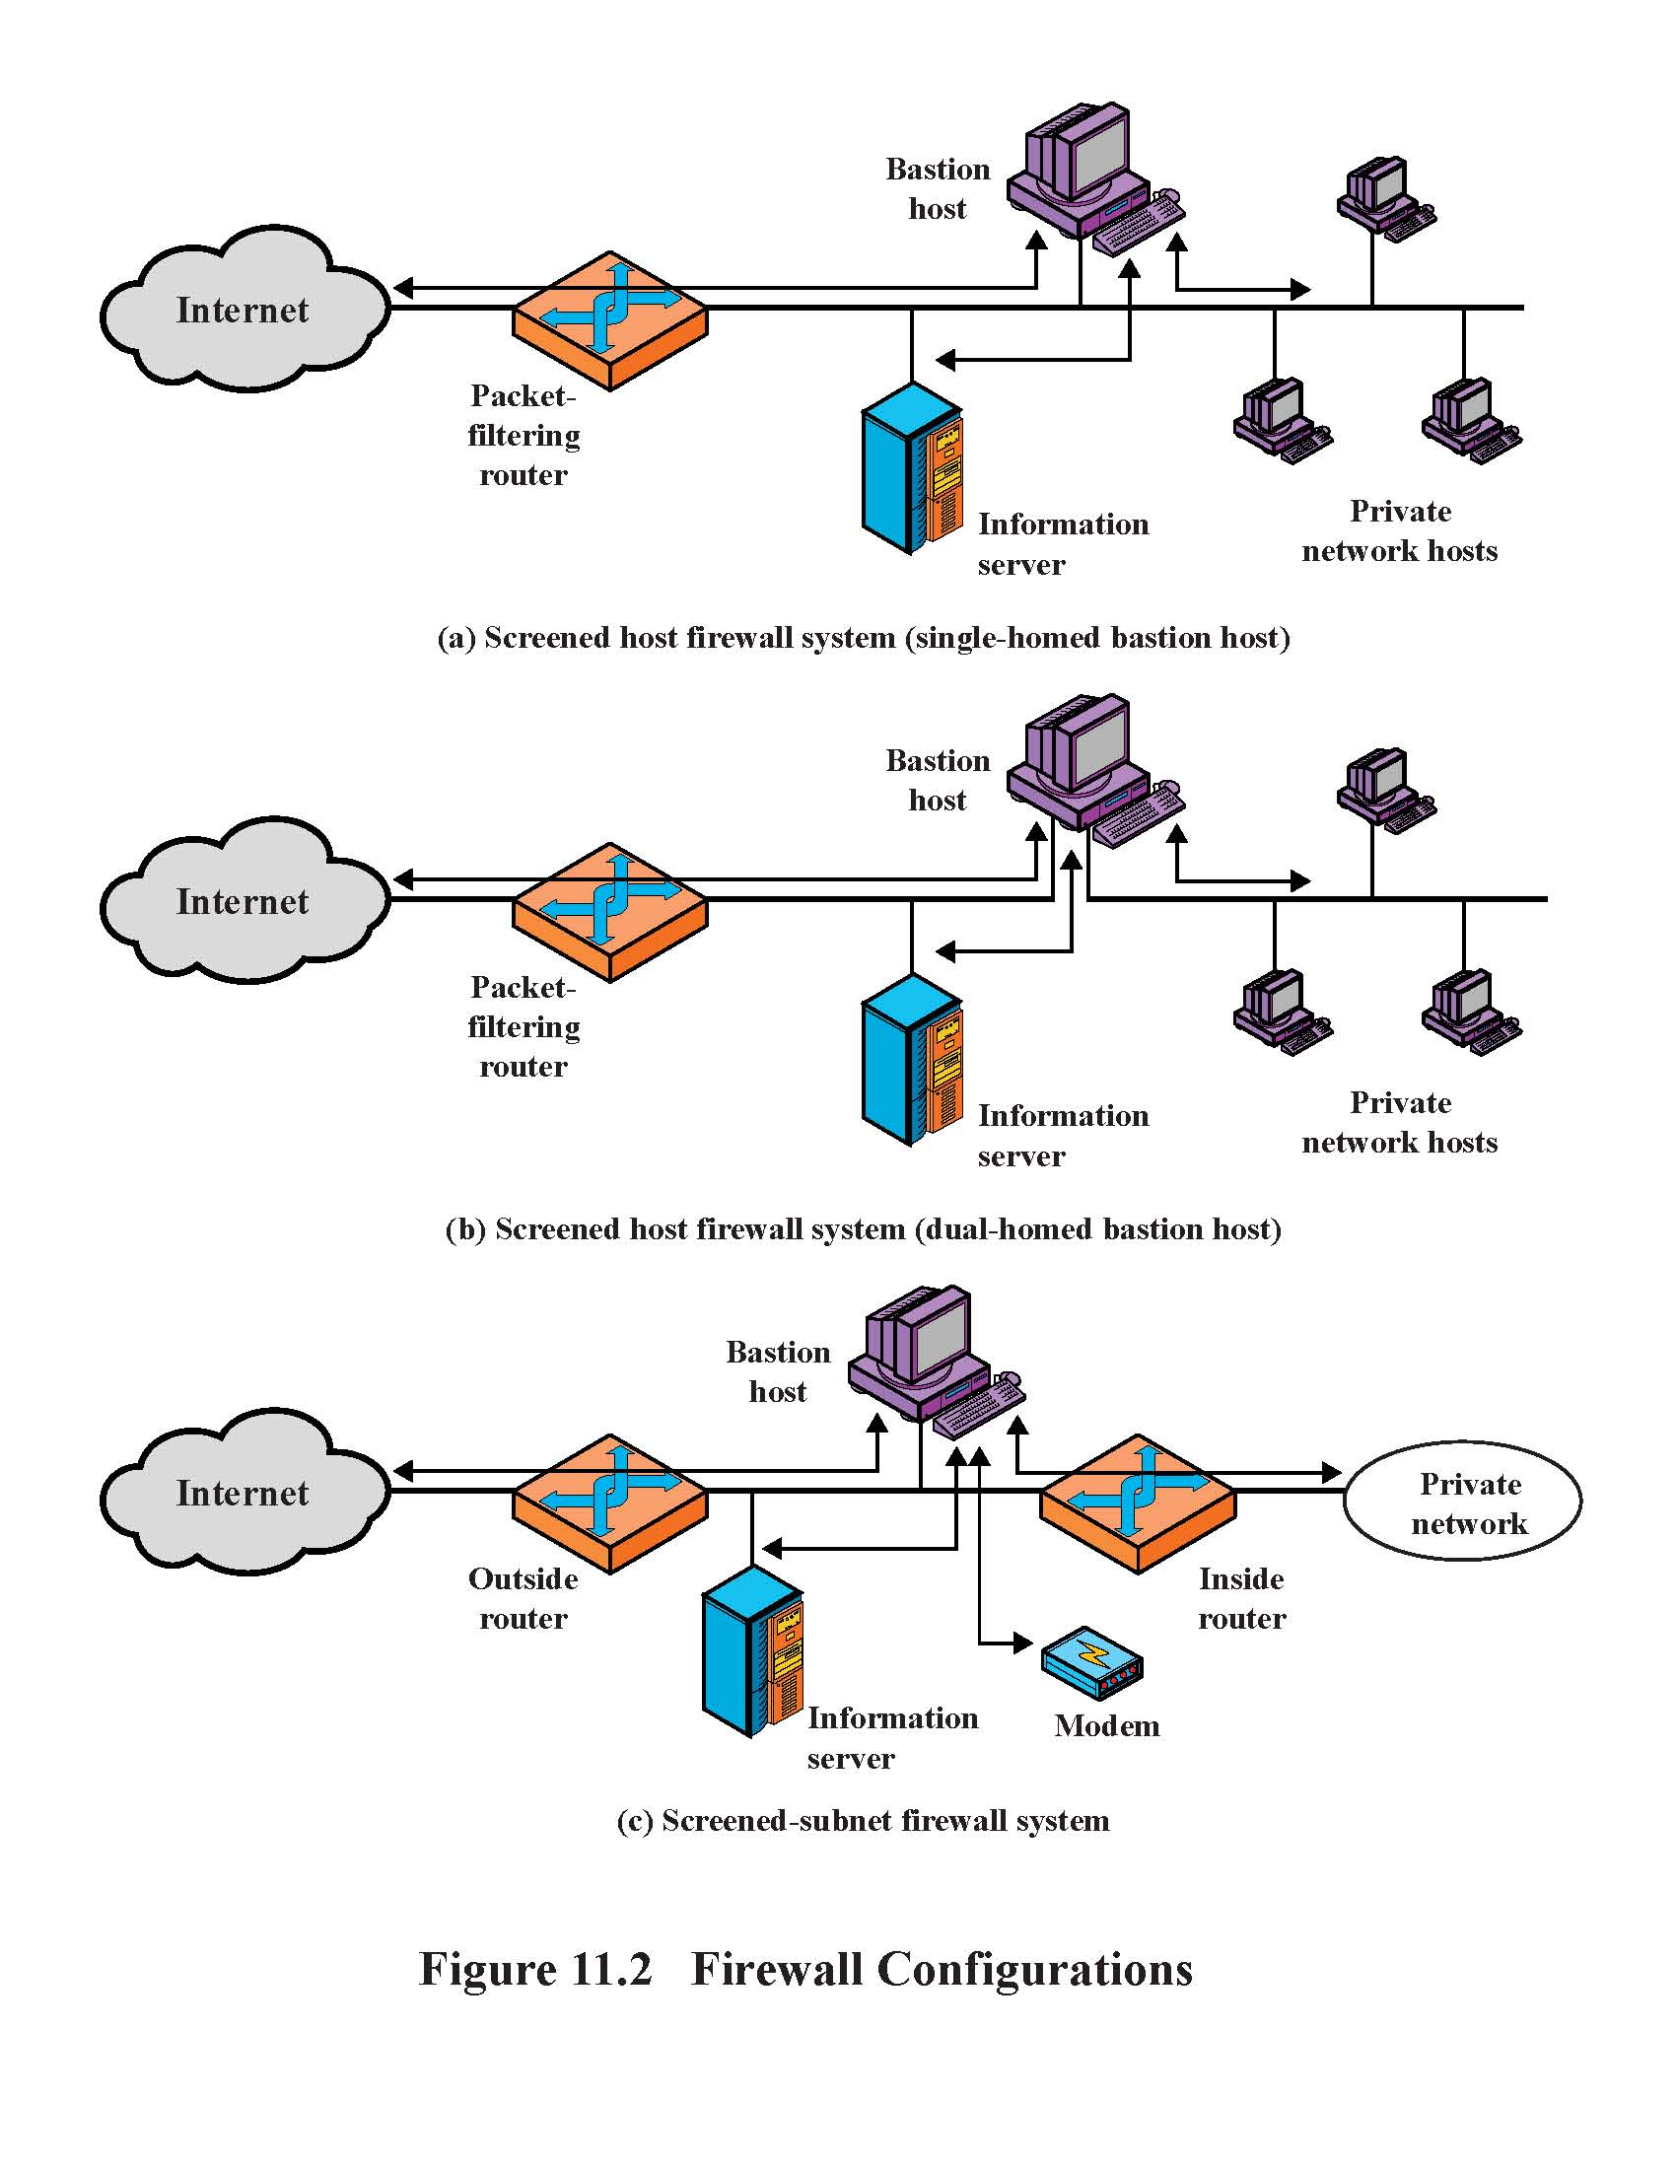
Single-Homed Bastion Host
If packet filter is compromised,
traffic can flow to interrnal network

Slide 24
Dual-Homed Bastion Host
No physical connection between
internal and external networks

Slide 25
Screened Subnet
Only the screened subnet is visible
to the external network;
internal network is invisible

Slide 26
Protecting Addresses and Routes
Hide IP addresses of hosts on internal network
  Only services that are intended to be accessed from outside need to reveal their IP addresses
  Keep other addresses secret to make spoofing harder
Use NAT (network address translation) to map addresses in packet headers to internal addresses
  1-to-1 or N-to-1 mapping
Filter route announcements
  No need to advertise routes to internal hosts
  Prevent attacker from advertising that the shortest route to an internal host lies through him

Slide 27

NAT: Network Address Translation
NAT translation table
WAN side addr LAN side addr
1: host 10.0.0.1
sends datagram to
128.119.40, 80
2: NAT router
changes datagram
source addr from
10.0.0.1, 3345 to
138.76.29.7, 5001,
updates table
138.76.29.7, 5001 10.0.0.1, 3345
…… ……
S: 10.0.0.1, 3345
D: 128.119.40.186, 80
10.0.0.1
1
2
S: 138.76.29.7, 5001
D: 128.119.40.186, 80
10.0.0.4
10.0.0.2
138.76.29.7
S: 128.119.40.186, 80
D: 10.0.0.1, 3345
4
S: 128.119.40.186, 80
D: 138.76.29.7, 5001
3
10.0.0.3
4: NAT router
changes datagram
dest addr from
138.76.29.7, 5001 to 10.0.0.1, 3345
3: Reply arrives
dest. address:
138.76.29.7, 5001

Slide 28
General Problems with Firewalls
Interfere with networked applications
Don’t solve the real problems
  Buggy software (think buffer overflow exploits)
  Bad protocol design (think WEP in 802.11b)
Generally don’t prevent denial of service
Don’t prevent insider attacks
Increasing complexity and potential for misconfiguration

Slide 29
Network Telescopes and Honeypots
Monitor a cross-section of Internet address space
  Especially useful if includes unused “dark space”
Attacks in far corners of the Internet may produce traffic directed at your addresses
  “Backscatter”: responses of DoS victims to randomly spoofed IP addresses
  Random scanning by worms
Can combine with “honeypots”
  Any outbound connection from a “honeypot” behind an otherwise unused IP address means infection
  Can use this to extract worm signatures

Slide 30
Scanning Detection and Defense
Port scan is often a prelude to an attack
  Someone is investigating which network services are available on your machine
    Looking for an old version of some daemon with unpatched buffer overflow?
Scan suppression: block traffic from addresses that previously produced too many failed connection attempts
  Goal: detect port scans from attacker-controlled hosts
  Requires network filtering and maintaining state
  Can be subverted by slow scanning; does not work very well if the origin of scan is far away

Slide 31
Stepping Stones
IP traceback helps discover machines from which attack packets originates
  These often have remote-controlled zombie daemons
  Analysis of zombies can help trace back to masters
Compromised host often has a root backdoor
  E.g., attacker runs TFN masters through root shell
  Standard service on a non-standard port or standard port associated with a different service
  Attacker connects from yet another machine
Stepping stone: compromised intermediary host used by attacker to hide his identity

Slide 32

General Principle
Find invariant or at least highly correlated characteristics of network links used by attacker
Leverage particulars of how interactive traffic behaves
A
M
C
Network monitor observes inbound and outbound traffic
B

Slide 33
Indirect Stepping Stones
Indirect stepping stone: “A-B … C-D” vs. “A-B-C”
B
A
M
Internet
D
C

